Slide 1
Task 1: Prompt Engineering
Made and presented by: Hasan Abu Hejleh, Verzhinia Achova, Leila Abdelelah, Mariam Ahmed, Suhaib Abubakar
Date: 29.11.2025

Slide 2
Table of contents
01
02
03
04
Limitations of LLMs
What is RAG and why do we need it
You can describe the topic of the section here
You can describe the topic of the section here
Prompt engineering and prompting techniques
Examples
You can describe the topic of the section here
You can describe the topic of the section here

Slide 3

Limitations of LLMs
01

Slide 4
Limitations of LLMs
Hallucinations
Models “confidently make up” facts when:
They don’t know the answer
The prompt is vague
Context is missing
Knowledge cutoff
LLMs cannot access new data unless provided.
While LLMs are powerful and have a lot of potential they are not perfect.
Two main issues LLMs face are:

Slide 5
Hallucinations
LLMs generate text by predicting the next word based on patterns learned from training data.
They do not verify facts, so when:
the training data is incomplete,
the question has no clear answer,
the context is ambiguous,
or the prompt encourages a confident tone…
…the model may produce statements that sound right but are wrong.
This is called hallucination.
Deep cause:
LLMs optimize for probability, not truthfulness. They do not perform factual checking or database lookup.

Slide 6
Knowledge Cutoff
LLMs are trained on a fixed dataset.
Anything that happens after that dataset (e.g., events, new research, updated laws) is unknown to them.
Even if they try to answer:
They guess
They hallucinate recent information
They may confidently state outdated facts
Deep cause:
Models are static snapshots of the world, not continuously updated systems.

Slide 7
Domain Blind Spots
LLMs struggle in:
medical accuracy
legal precision
scientific calculations
proprietary data
organization-specific knowledge
Because they cannot access internal documents or updated research by default.
Lack of Source Transparency
LLMs cannot cite exact sources from training.
They cannot tell you “where” a fact came from.

Slide 8
02
What is RAG and why do we need it
You can enter a subtitle here if you need it

Slide 9
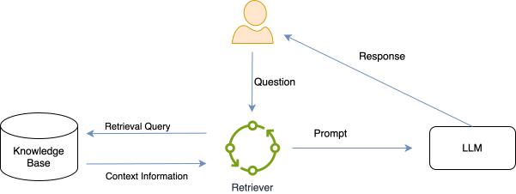
What is RAG and why do we need it
RAG = Retrieval-Augmented Generation
It solves LLM limitations by:
Retrieving real documents before generating answers
Adding missing context to reduce hallucinations
Keeping responses grounded in actual data
Updating knowledge dynamically

Slide 10
RAG has two main stages:
1. Retrieval
2. Generation
Break documents into chunks
Embed and store in vector DB
Retrieve top-k relevant chunks based on a question
Insert retrieved text into prompt template
LLM produces grounded answer
This ensures the model uses real information instead of guessing.

Slide 11
03
Prompt engineering and prompting techniques

Slide 12
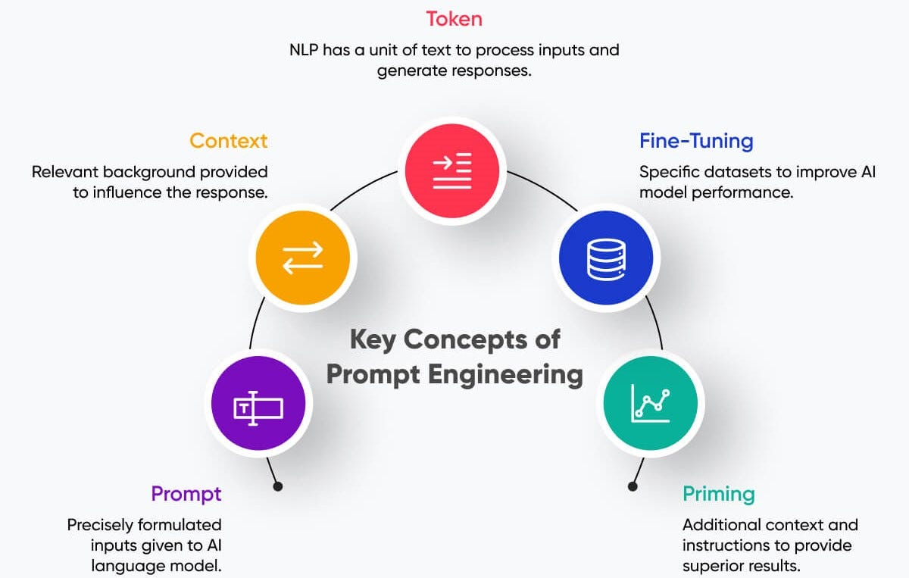
Prompt Engineering
Prompt engineering means designing inputs that guide an LLM effectively.
Good prompting includes:
- Giving clear instructions
- Providing examples (few-shot)
- Enforcing reasoning steps
- Setting role or rules
- Supplying context

Slide 13
Prompting Techniques
1. Zero-Shot Prompting
2. Few-Shot Prompting
Provide 2–3 examples.
Improves consistency.
Ask the model with no examples.
Useful for simple tasks.
3. Chain-of-Thought Prompting
4. Retrieval-Augmented Prompting
Ask the model to “show reasoning step-by-step”.
Helpful for logic problems.
Insert retrieved text into the prompt.
Reduces hallucinations dramatically.

Slide 14
Structured Instruction Prompt (Best Practice)
Good Prompt
“You are a networking tutor.
Goal: Explain the OSI model.
Constraints: Use simple language, 7 bullet points, one per layer.
Output: A clean list only.”
Why it’s good
Clear role
Clear goal
Constraints → reduce ambiguity
Defined output format

Slide 15
Few-Shot Prompt (High Reliability for Patterns)
Good Prompt
“Rewrite sentences into formal academic tone.
Examples:
‘Kids today use phones a lot.’ → ‘Contemporary adolescents frequently utilize mobile devices.’
‘The results were kind of unclear.’ → ‘The results demonstrated a degree of ambiguity.’
Now rewrite: ‘People don’t exercise enough.’”
Why it’s good
Shows patterns
Reduces hallucination
Prevents misunderstanding of the desired style

Slide 16
Chain-of-Thought Prompt (For reasoning tasks)
Good Prompt
“Show your reasoning step-by-step.
Explain how Dijkstra’s algorithm finds the shortest path.
Then provide a 3-bullet summary at the end.”
Why it’s good
Forces the model to think before answering
Produces structured reasoning
Avoids incorrect shortcuts

Slide 17
Retrieval-Aware Prompt (For accuracy)
(This is what you say in a RAG system)
Good Prompt
“Using only the provided document excerpts, summarize the key points in 5 bullets.
Do not add information that is not present in the excerpts.”
Why it’s good
Prevents hallucination
Grounds the model
Explicit boundary: “only use these excerpts”

Slide 18
Thank you!

Slide 20




Slide 21

Image always reinforce
the concept
You can give a brief description of the topic you want to talk about here. For example, if you want to talk about Mercury, you can say that it’s the smallest planet in the entire Solar System

Slide 22

4,498,300,000
Big numbers catch your audience’s attention

Slide 23
9h 55m 23s
333,000
386,000 km
Jupiter’s rotation period
The Sun’s mass compared to Earth’s
Distance between the Earth and the Moon

Slide 24
Awesome words

Slide 25

A picture is worth a thousand words

Slide 26
Practical exercise - calculator
Objective:
Introduce participants to basic coding concepts by building a simple calculator
Instructions:
Open a Python development environment and write the following code:
# Simple Calculator
num1 = int(input("Enter the first number: "))
num2 = int(input("Enter the second number: "))
print("Sum:", num1 + num2)
print("Difference:", num1 - num2)
print("Product:", num1 * num2)
print("Quotient:", num1 / num2)
Run the program and experiment with different numbers
Observe the output

Slide 27
Brainstorm and idea generation
Mercury
It’s the smallest planet of them all
Earth
Venus
Venus is the second planet from the Sun
Power 1
Neptune
It’s the farthest planet from the Sun
Mars
Saturn
Saturn was named after a Roman god

Slide 28
Main topic and details
Mars
Neptune
Despite being red, Mars is very cold
It’s the farthest planet from the Sun
Jupiter
Saturn
Jupiter is the biggest planet of them all
It’s a gas giant and has several rings

Slide 29
Popular programming languages
01
Neptune
Mercury is the closest planet to the Sun and the smallest of them all
02
Venus
Venus has a beautiful name and is the second planet from the Sun
03
Earth
Earth is the third planet from the Sun and the only one that harbors life in the Solar System
04
Saturn
Saturn is a gas giant and has several rings. It’s composed mostly of hydrogen and helium

Slide 30
Sequences
Saturn is composed of hydrogen and helium
Mercury is the closest planet to the Sun
Jupiter was named after a Roman god
First
Next
Next
Next
Next
Last
Despite being red, Mars is very cold
Earth is the third planet from the Sun
Venus has extremely high temperatures

Slide 31
Classification
Mars | Venus | Mercury | Jupiter
Small Red Cold Rocky | Small Hot Dry Volcanic | Small Hot Rocky Cratered | Large Cold Gassy Striped
Mars is full of iron oxide dust | Venus has high temperatures | Mercury is quite a small planet | Jupiter is a huge gas giant

Slide 32
Cause and effect
Mars
Venus
Problem
Despite being red, Mars is very cold
Venus is the second planet from the Sun
Mercury
Saturn
Solution
Mercury is the closest planet to the Sun
Saturn is a gas giant and has several rings

Slide 33
Question and answer
Question
Is Mercury the closest planet to the Sun and the smallest one in the Solar System? Note that it’s a bit larger than the Moon
Answer
Venus has a beautiful name and is the second planet from the Sun. It’s hot and has a poisonous atmosphere

Slide 34
Step-by-step coding
01
02
03
04
Earth
Mercury
Jupiter
Saturn
It’s the only planet known to harbor life
Mercury is the closest planet to the Sun
Jupiter is the biggest planet of them all
Saturn was named after a Roman god

Slide 35
Parts and whole
The whole objective
Parts of the object
What happens if the parts are missing?
Mercury is the closest planet to the Sun and the smallest one in the entire Solar System
Mercury
Jupiter
Venus
Mars
Earth
Saturn
Mercury
Earth is the third planet from the Sun and the only one that harbors life in the Solar System
What’s the function of the parts?
Jupiter is a gas giant and the biggest planet in the Solar System

Slide 36
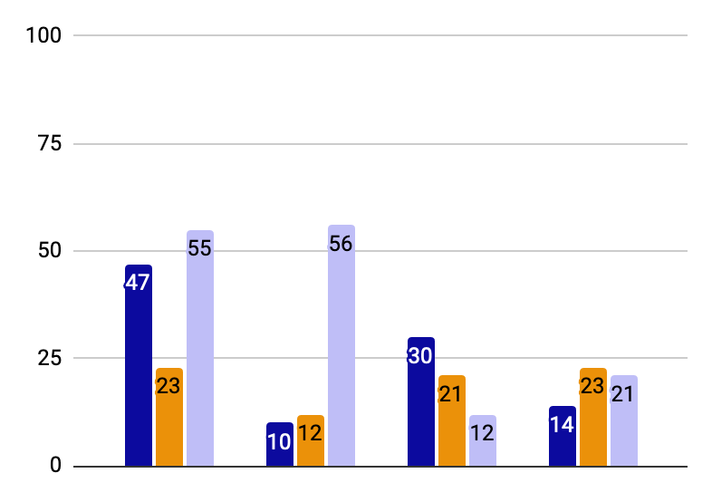
You can use this graph
Mercury
Mercury is the closest planet to the Sun
Jupiter
Jupiter is the biggest planet of them all
Saturn
Saturn was named after a Roman god
Follow the link in the graph to modify its data and then paste the new one here. For more info, click here

Slide 37
This is a map
USA
Russia
Despite being red, Mars is very cold
Neptune is the farthest planet from the Sun
India
China
Jupiter is the biggest planet of them all
Saturn is a gas giant and has several rings

Slide 38
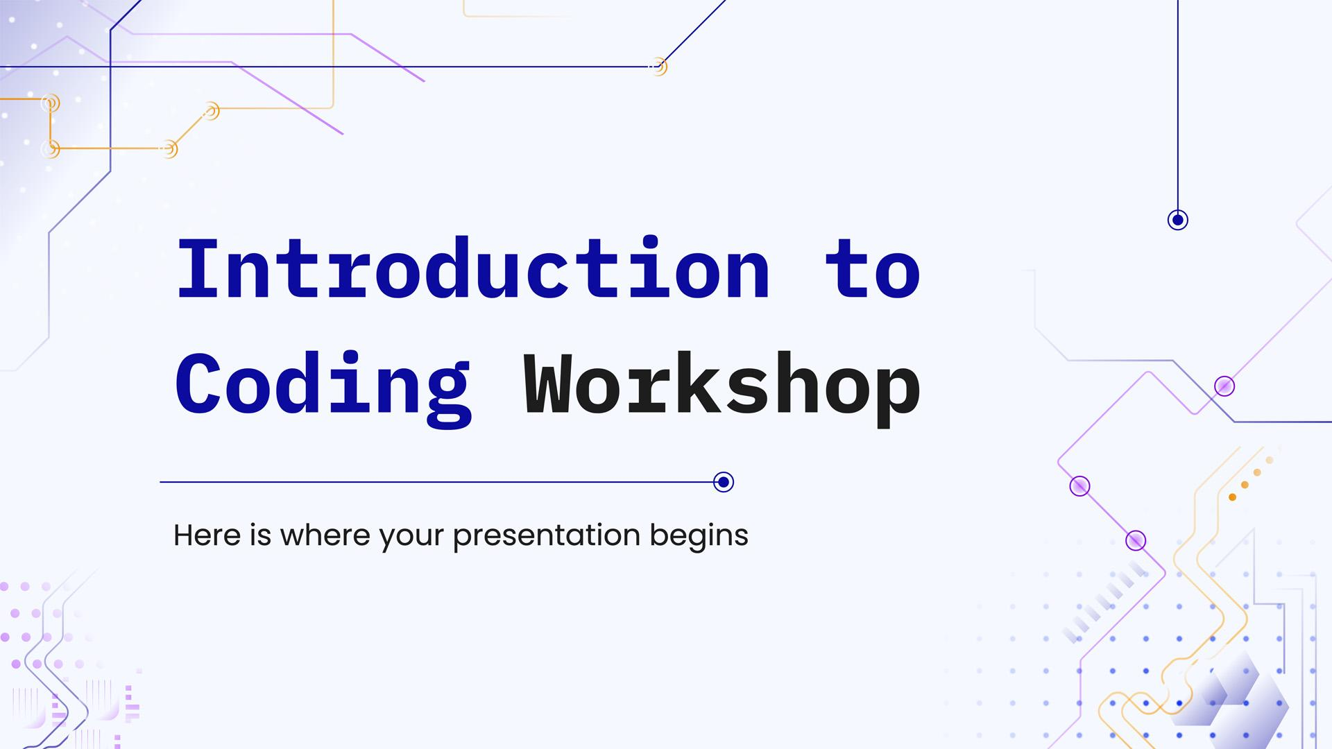
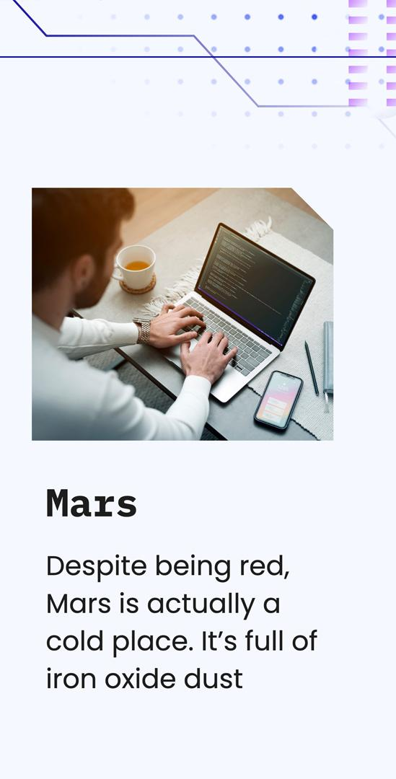
Mockups
You can replace the images on the screen with your own work. Just right-click on them and select “Replace image”

Slide 39
Thanks!
Do you have any questions?
youremail@freepik.com
+34 654 321 432
yourwebsite.com
Please keep this slide for attribution

Slide 40
Icon pack

Slide 41
Alternative resources
Here’s an assortment of alternative resources whose style fits that of this template:

Slide 42
Resources
Did you like the resources in this template? Get them for free at our other websites:
Photos:
Medium shot man working on laptop
Group of friends planning a trip in a cafe
Medium shot man working on laptop
Side view of men working on laptops at the office
Lifestyle of woman in the office
Secretary working on laptop
Vectors:
Abstract gradient circuit board background
Icon pack:
Icon Pack: Coding | Lineal

